Slide 1
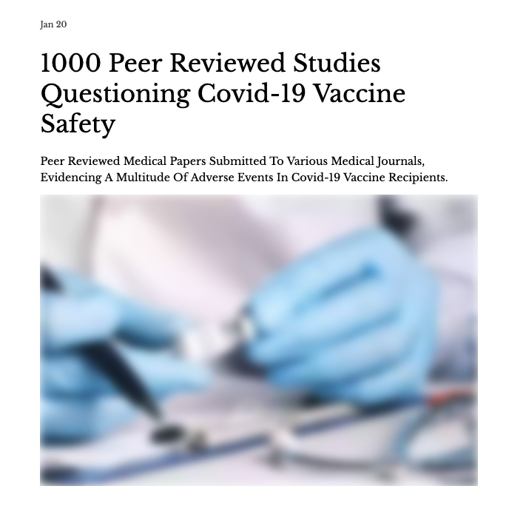
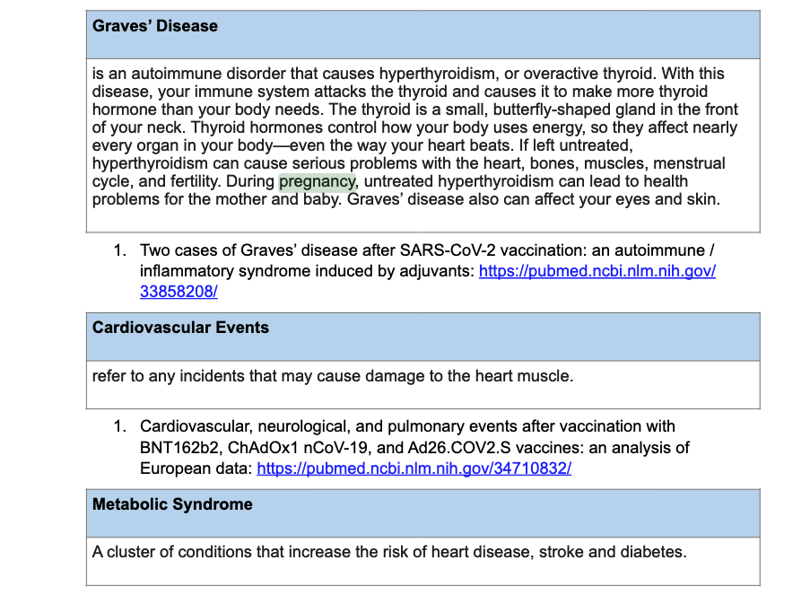

44. Myocarditis / pericarditis associated with COVID-19 vaccine: https://science.gc.ca/
eic/site/063.nsf/eng/h_98291.html
45. The new COVID-19 mRNA vaccine platform and myocarditis: clues to the possible
underlying mechanism: https://pubmed.ncbi.nlm.nih.gov/34312010/
46. Myocarditis associated with COVID-19 vaccination: echocardiographic, cardiac
tomography, and magnetic resonance imaging findings: https://www.ahajournals.org/
doi/10.1161/CIRCIMAGING.121.013236
PRESENTED BY DR. ERIC FEINTUCH, D.C.

Slide 2
The Future Framework is based on immune bridging and its a failed model.
We should be looking not just at the level of antibody, but the types of antibodies functionally that are made?
There is no public repository nor is there quality assured which will help correlate protection data
The cycle time for new variants can be every 3-6 months and what would the vaccine uptake be?
Who is willing to take vaccines that frequently?
The youngest in our population is not driving the spread of the infection, so why are you prioritizing them?

Slide 3
The Future Framework is based on immune bridging and its a failed model.
We have to stop this over simplification and marketing of “immune bridging” which circumvents requiring clinical studies and pretend that this is a new kind of “new math”
We urgently need to create a correlative protection equation that doesn’t just include neutralizing antibodies.
A future framework that excludes T-cell production, B-cell production macrophage levels and other unique aspects of our immune system is a recipe for disaster.
Creating an Omicron specific vaccine doesn’t make sense because of antagenic sin!
All vaccinees get continually boosted by Omicron as it circulates like hell.
The whole mass vaccine campaign is about to collapse and your actions today are going to hasten that collapse, by proving once again, there is no product that you will not encourage the public use, in spite of the terrible safety signals and scant data in which you are authorizing the use of these gene therapy products.

Slide 4
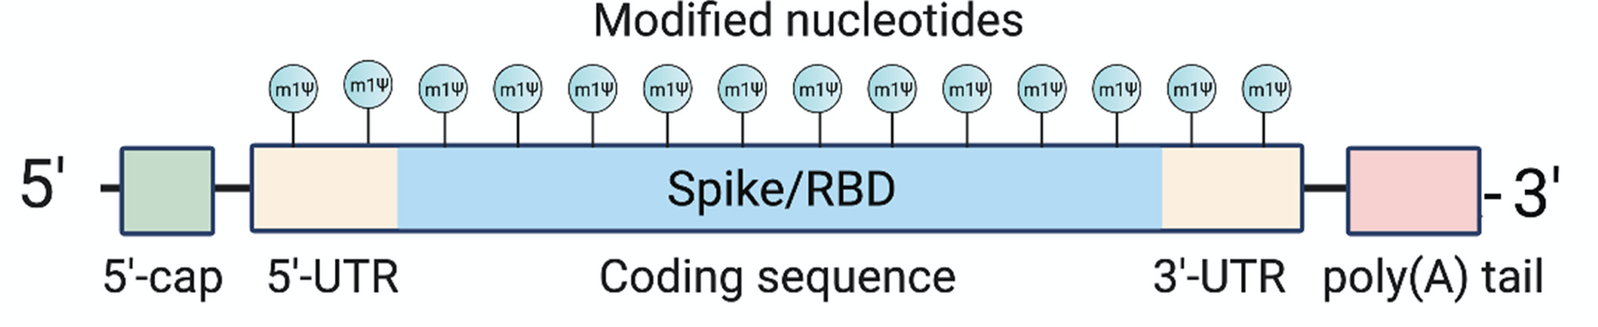
How long does the mRNA from the vaccines stay in the body?
How long does it continue to produce spike protein?
What is it’s rate of protein production?
What are the consequences of the methylpseudouridine substitutions and the codon optimization step?
How about the humanized cap and UTRs and the long poly-A tail?
https://ijvtpr.com/index.php/IJVTPR/article/view/23
InalienableRightsAlliance@protonmail.com

Slide 5
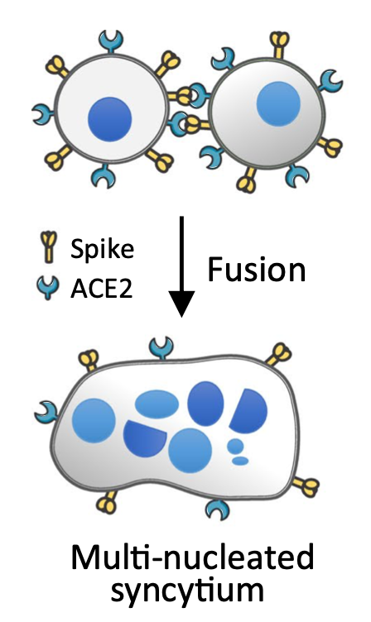
Spike protein causes infected cells to fuse into a giant multi-nucleated cell.
Presence of micronuclei in those cells indicates DNA double strand breaks
-> genetic mutations -> cancer
He Ren et al. 2021.
https://pubmed.ncbi.nlm.nih.gov/34674770/

Slide 6
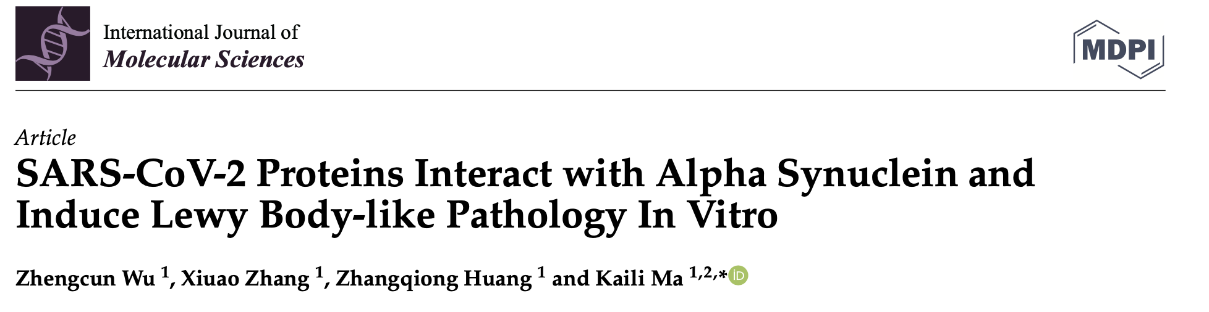
How can you assure us that the mRNA vaccines won’t cause Parkinson’s disease, CJD (Creutzfeldt Jakob disease)?, increase cancers
How can you assure us that the spike protein won’t lead to an increase in cancer rates or a reemergence of a cancer in remission?
https://pubmed.ncbi.nlm.nih.gov/35328814/

Slide 7
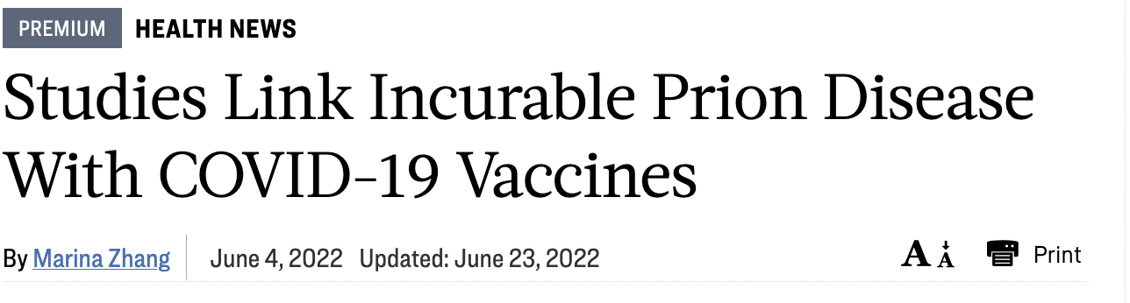
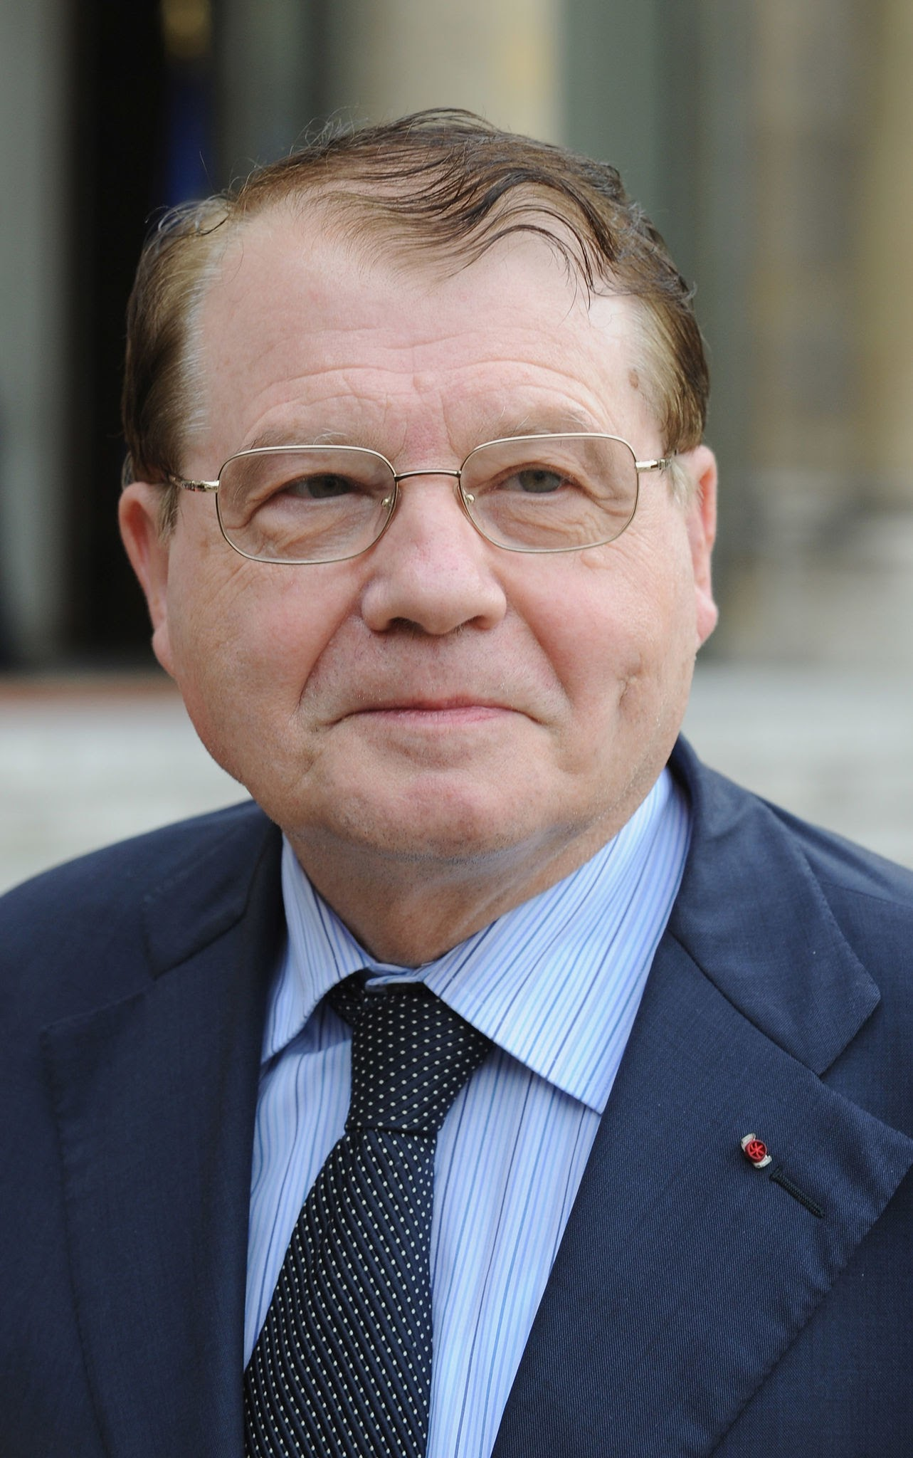
PROF. LUC MONTAGNIER’S PREPRINT PAPER:
The 2008 Nobel Prize in Physiology or Medicine for his discovery of the human immunodeficiency virus. HIV
26 people developed symptoms of CJD (prion disease) within one month of their second mRNA vaccine
Many died within 3 months
All are now dead
Photo credit: Getty Images/Pascal Le Segretain
https://www.hopkinsmedicine.org/health/conditions-and-diseases/prion-diseases

Slide 8
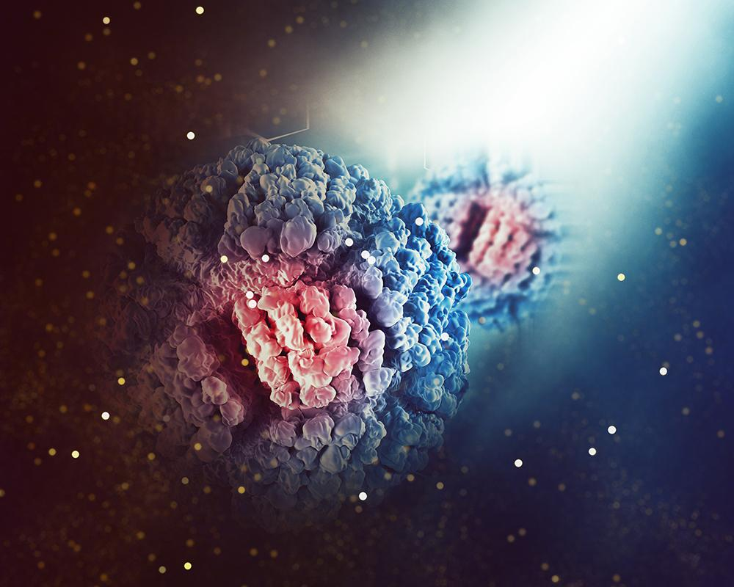
How can you assure us that the mRNA vaccines won’t cause

Slide 9
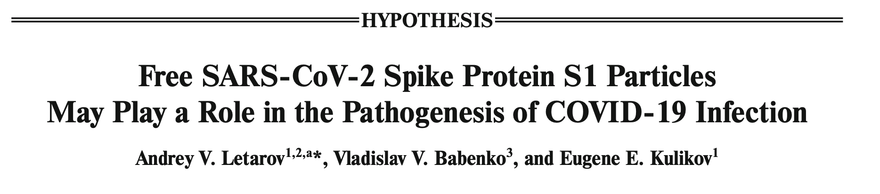
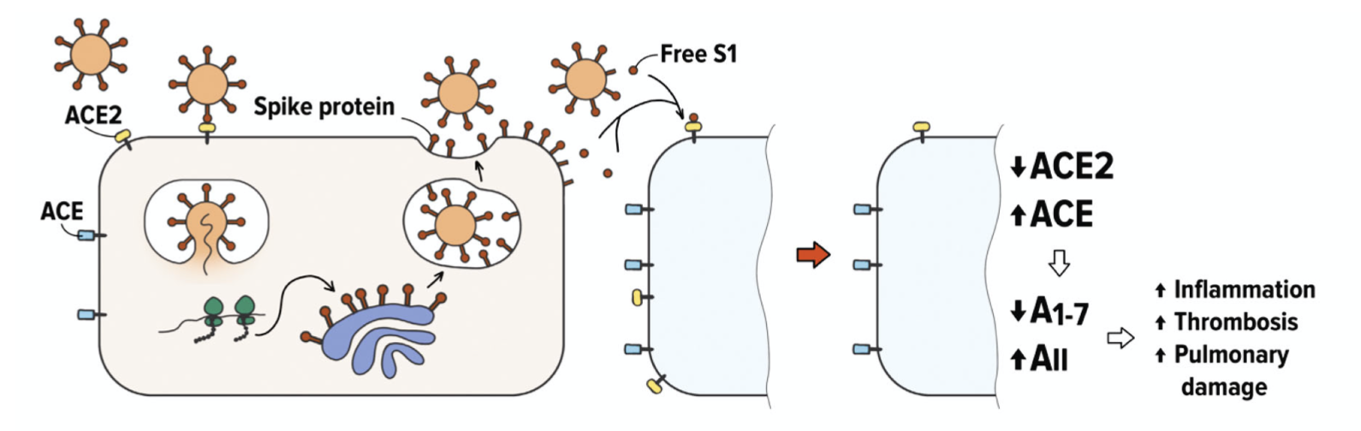
https://pubmed.ncbi.nlm.nih.gov/33838638/

Slide 10
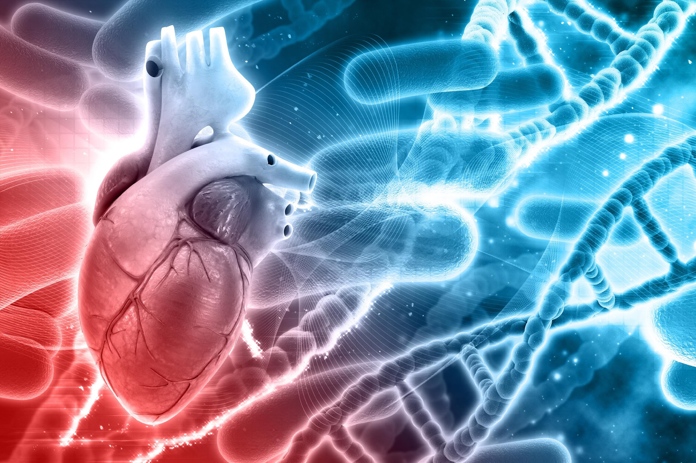
How can you assure us that using the “future framework” will not multiply the negative effect that produces myocardiopathies, heart conditions and blood clotting?

Slide 11
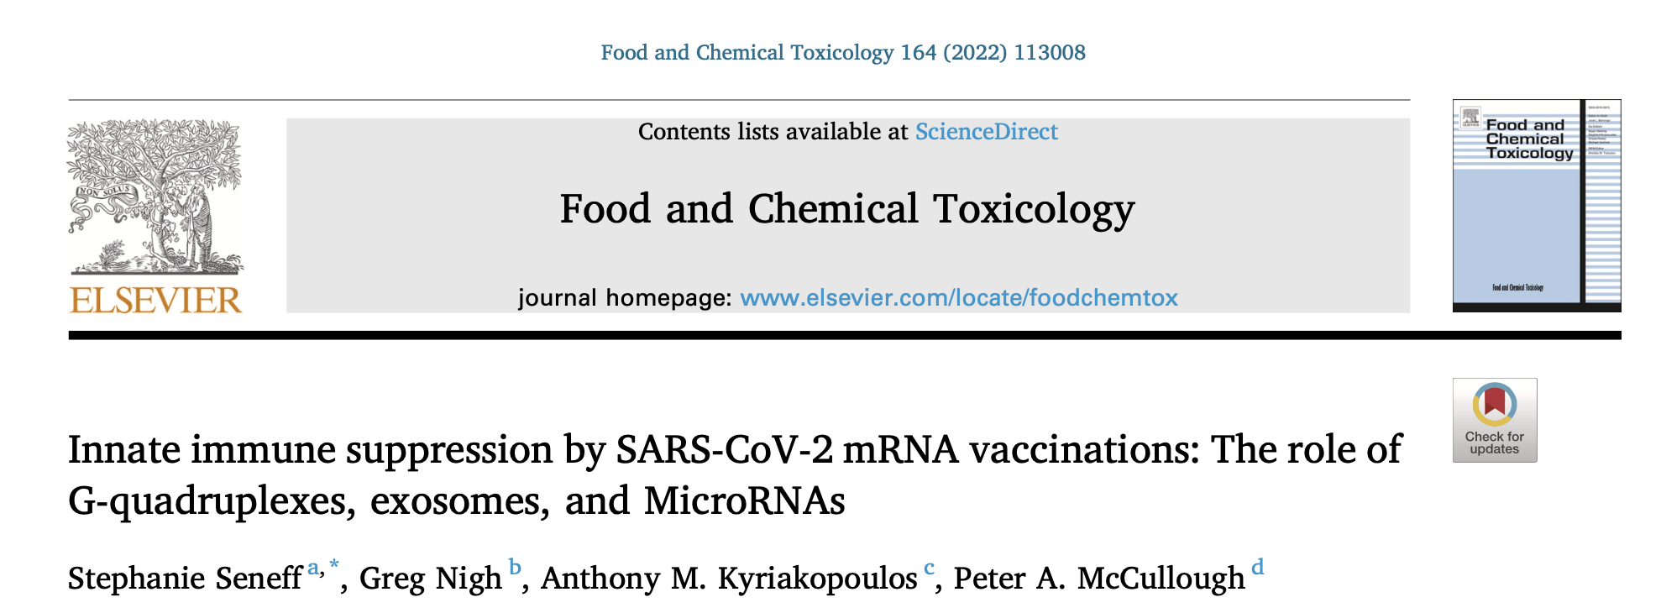
How can you assure us that the mRNA vaccines won’t suppress the innate immune system, leading to increased risk to infections and cancer?
https://www.mdpi.com/1467-3045/44/3/73/htm

Slide 12
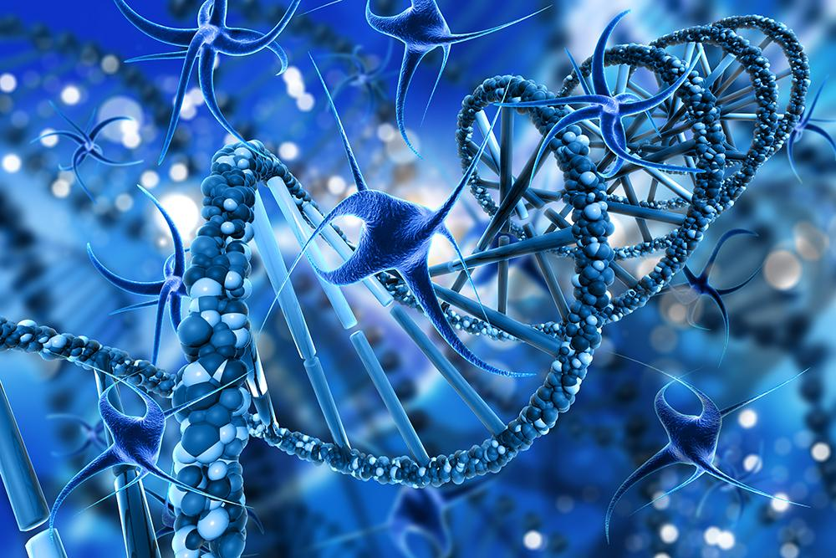
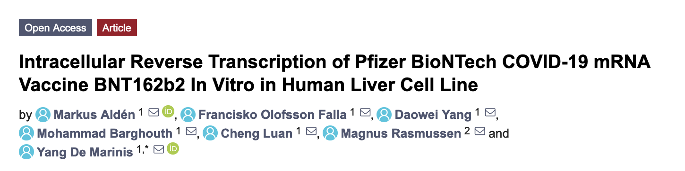
How can you assure us that the mRNA in the vaccines won’t get converted into DNA by human cells and ultimately integrated into the human genome?
https://pubmed.ncbi.nlm.nih.gov/35436552/

Slide 13
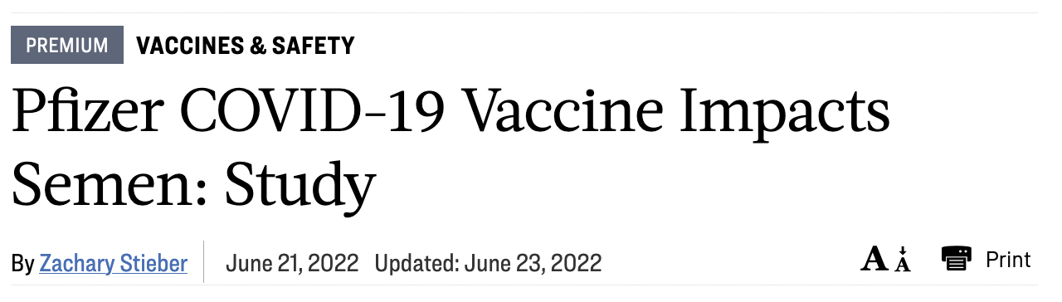
How can you assure us that the mRNA vaccines won’t cause male infertility?
https://pubmed.ncbi.nlm.nih.gov/35713410/

Slide 14
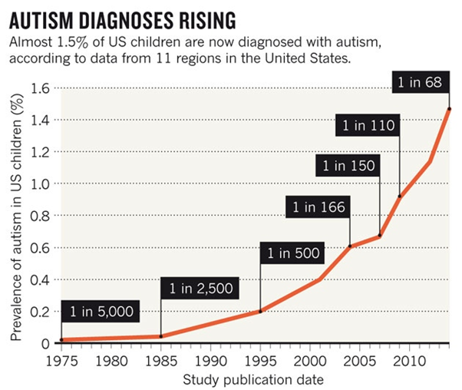
Is this not a frightening trend?*
*K. Weintraub, Nature 479, Nov. 3 2011, 22-24.

Slide 15
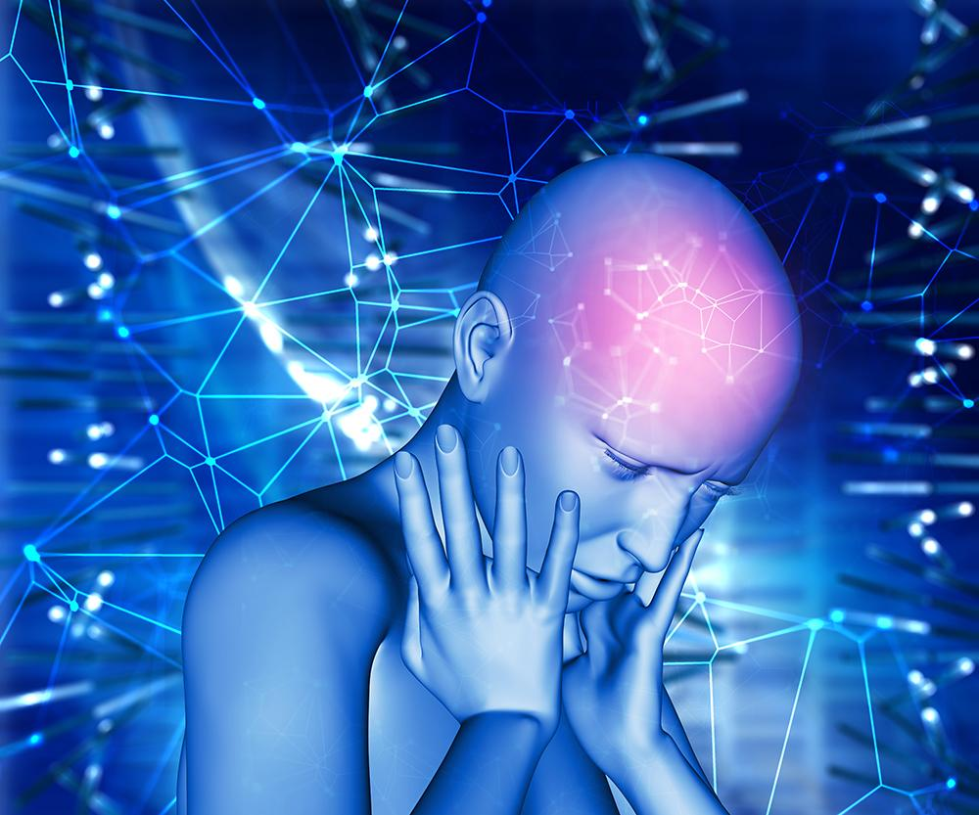
How can you assure us that the mRNA vaccines won’t cause autism in children?
*K. Weintraub, Nature 479, Nov. 3 2011, 22-24.

Slide 16
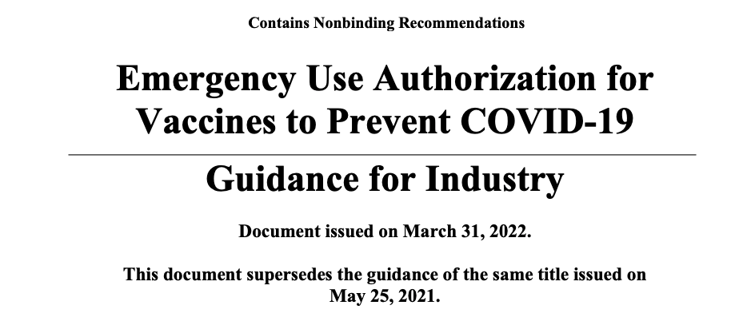
You DENY the VAERS data, information that has received over 2 million+ complaints.
You DENY that the data from 1000s of peer to peer review articles that say clearly this is NOT SAFE and NOT EFFECTIVE!
U.S. Department of Health and Human Services
Food and Drug Administration
Center for Biologics Evaluation and Research
March 2022
Are you following your own guidelines?
FDA - Federal Denial Administration
https://www.fda.gov/media/142749/download

Slide 17
If these “shots” are deemed “safe and effective”, by almost every governmental public service announcement, including recently by Dr. Marks himself, then why the continued reliance on the emergency use authorization (EUA) version of the shot and why is the truly approved shot, not available for US in the US as of June 28th, 2022 (today), almost a year after it was approved.
Comirnaty,
where art thou?
https://www.fda.gov/emergency-preparedness-and-response/coronavirus-disease-2019-covid-19/comirnaty-and-pfizer-biontech-covid-19-vaccine

Slide 18

44. Myocarditis / pericarditis associated with COVID-19 vaccine: https://science.gc.ca/
eic/site/063.nsf/eng/h_98291.html
45. The new COVID-19 mRNA vaccine platform and myocarditis: clues to the possible
underlying mechanism: https://pubmed.ncbi.nlm.nih.gov/34312010/
46. Myocarditis associated with COVID-19 vaccination: echocardiographic, cardiac
tomography, and magnetic resonance imaging findings: https://www.ahajournals.org/
doi/10.1161/CIRCIMAGING.121.013236

